Slide 1
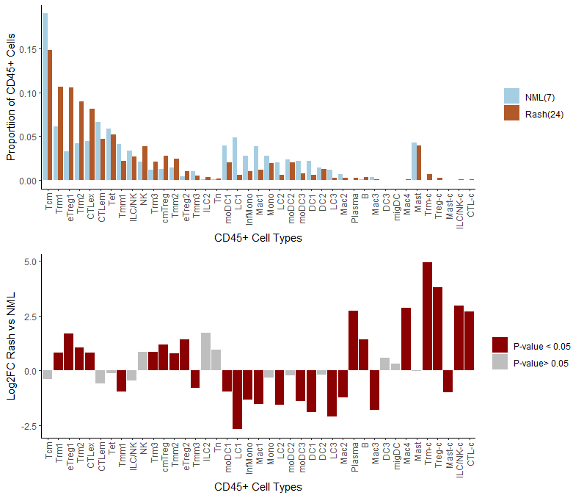
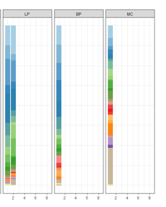
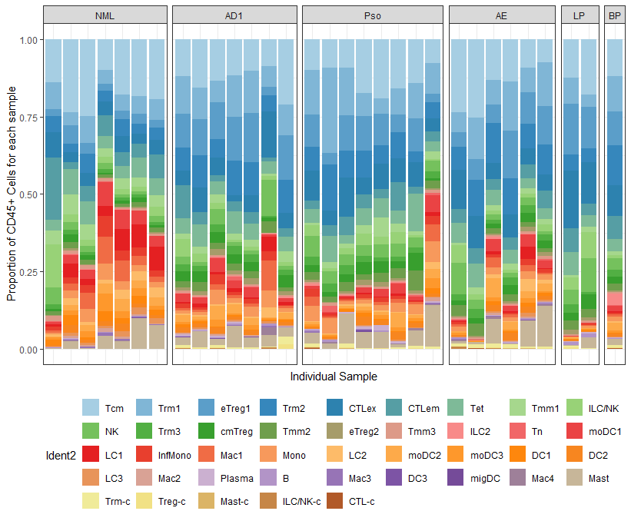
A
C
B
Notes:
Rachel:
Please keep what you have in your version of the figure except :
substitute this new panel C with 6 additional samples for current panel C but
Change AD1 to AD in 2nd grouping on top label
Keep the lack of brackets on bottom as in your current figure (see rachel’s version subfolder)
Separate Individual sample label from the colored boxes on the bottom. The individual samples refers to each bar above. The colored boxes are actually the key for the colors above. Right now individual samples looks like it’s labeling the colored boxes.
2) For panel a, proportion is mis-spelled, also, please change 26 to 24 after rash
3) + in CD45+ should be superscript in all 3 panels

